Slide 2
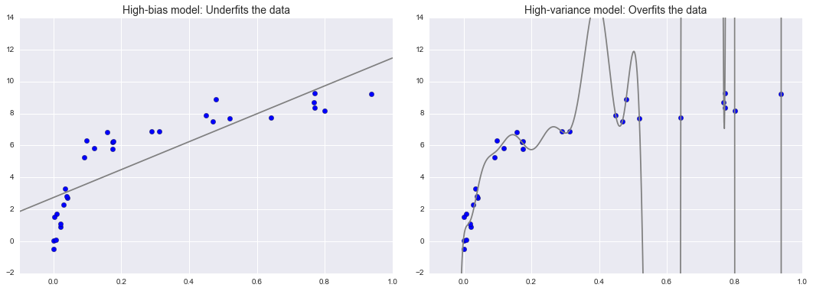
Over and Underfitting
Neural Networks tend to over- or underfit the data.
Model is missing flexibility
The model is not able to model the data no matter how much training samples exist.
→ The result of the model will be straight up bad
Model fit has too much flexibility
Seems to pay too much attention random effects rather than the intrinsic properties of whatever process generated that data
The results lack of generalizsation and are therefore misleading

Slide 3
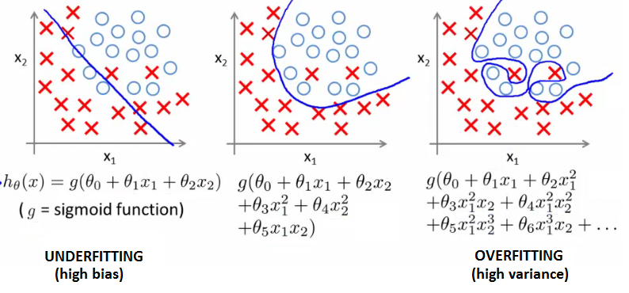
Over and Underfitting
High Bias
(Underfitting)
High Variance
(Overfitting)
The question of "the best model" is about finding a sweet spot in the tradeoff between bias and variance.

Slide 4
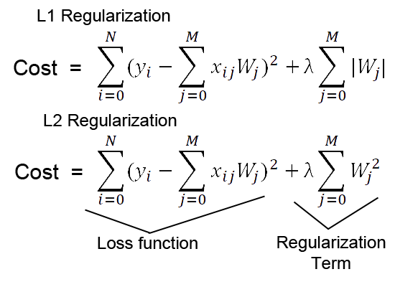
Weight Decay L1 & L2 Regularization
Overfitting is reflected as very high weights between particular neurons. A simple trick to counteract this phenomenon is to penalize unregulated weight growth in the loss/cost function directly. This is usually done by adding a regularization term. That is either linear (L1 reg.) or quadratic (L2 reg.)
MSE
Remember that while training we want to minimize this cost as much as we can!
These terms will blow up if the sum of all weights gets too high.
MSE

Slide 5

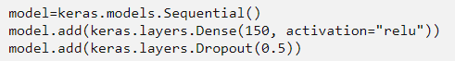
Dropout
Another way to prevent unregulated weight growth is the Dropout method. Dropout is a technique where randomly selected neurons are ignored during training. They are “dropped-out” randomly. This means that their contribution to the activation of downstream neurons is temporally removed on the forward pass and any weight updates are not applied to the neuron on the backward pass.
while Training while testing
This technique can be viewed as adding noise to the network. Despite even the authors of the paper don’t know why this actually works. Most importantly Dropout is only used during the training of a model only and is not used when evaluating the model.

Slide 6
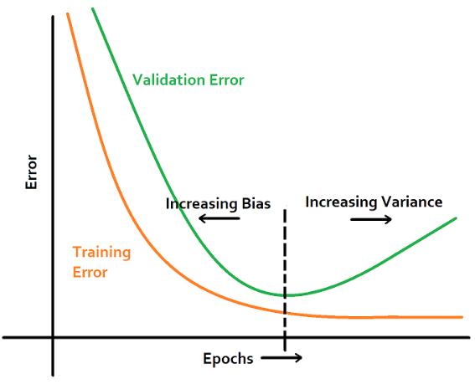
Early Stopping
Another sign of overfitting is the rise of the validation error while training the network. It is not an suprising behavior because the definition of overfitting is that overfitted models achieve worse.
With this plot it is possible to very effectively monitor the whole training process and determine the moment, timestamp the model stopped learning useful features.
If this point is monitored, Early Stopping is defined as an automatic early end of the training, if the validation error keeps increasing for a specific time period.
Keras Callbacks: Once we started the training in Keras, we are not able to access the process.
Callbacks are the only a way to tell Keras to run other predefined functions while doing the training loops.

Slide 7
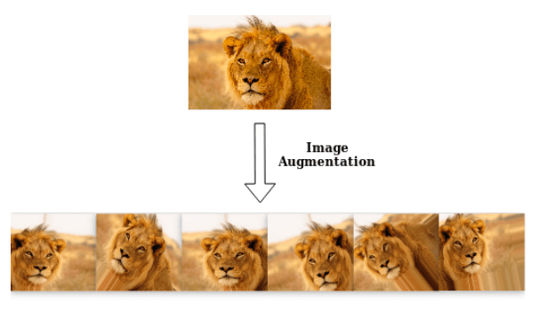
Data Argumentation
A very „cheap“ way to address overfitting is to create argumented data based on real sampels.
This technique can be used for both NLP (time series) and CV (images).
In CV we can use the techniques like Jitter, PCA and Flipping. Similarly in NLP we can use the techniques like Synonym Replacement, Random Insertion, Random Deletion and Word Embeddings.

Slide 8
5. Exercise Let‘s regularize our first classifier with Keras!

